Slide 1

Customer Shopping Behavior Analysis
Uncovering insights from 3,900 purchases to guide strategic business decisions

Slide 2
Dataset Overview
3,900
18
50
25
Total Purchases
Data Columns
Locations
Product Types
Transactions analyzed across all categories
Comprehensive customer and purchase attributes
Geographic diversity in customer base
Wide variety of items purchased
Key Features
Data Quality
Customer demographics
Only 37 missing values in Review Rating column - minimal data cleaning required
Purchase details & amounts
Shopping behavior patterns
Review ratings & shipping

Slide 3
Data Preparation Journey
01
02
03
Data Loading & Exploration
Missing Data Handling
Feature Engineering
Imported dataset, checked structure and summary statistics
Imputed Review Rating using median by product category
Created age_group and purchase_frequency_days columns
04
05
Data Consistency
Database Integration
Dropped redundant promo_code_used column
Connected to PostgreSQL for advanced SQL analysis

Slide 4
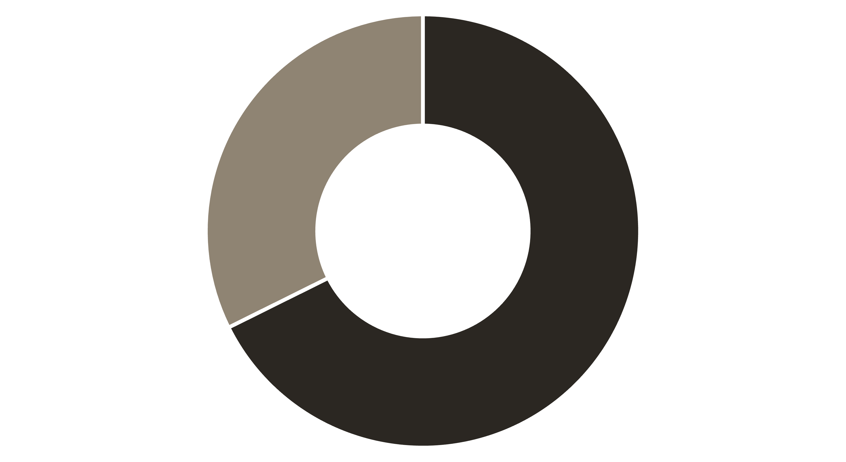
Revenue by Gender
Male
Female
Male Customers
Female Customers
Generate 68% of total revenue - dominant purchasing power
Represent untapped growth opportunity for targeted campaigns

Slide 5



High-Value Discount Users
839
21.5%
Smart Shoppers
Segment Size
Customers using discounts while spending above average
Significant portion of customer base
Key Insight: These customers are price-conscious but high-value - perfect targets for loyalty programs that balance discounts with increased purchase frequency

Slide 6

Product Performance Insights
Top-Rated Products
Discount-Dependent Items
Gloves - 3.86 rating
Hat - 50% discount rate
Sandals - 3.84 rating
Sneakers - 49.66%
Boots - 3.82 rating
Coat - 49.07%
Hat - 3.80 rating
Sweater - 48.17%
Skirt - 3.78 rating
Pants - 47.37%

Slide 7

Shipping & Spending Patterns
Standard Shipping
$58.46 average purchase
Most common shipping choice
Express Shipping
$60.48 average purchase
Higher-value customers prefer speed
Express shipping users spend 3.5% more on average - opportunity to promote premium shipping options

Slide 8
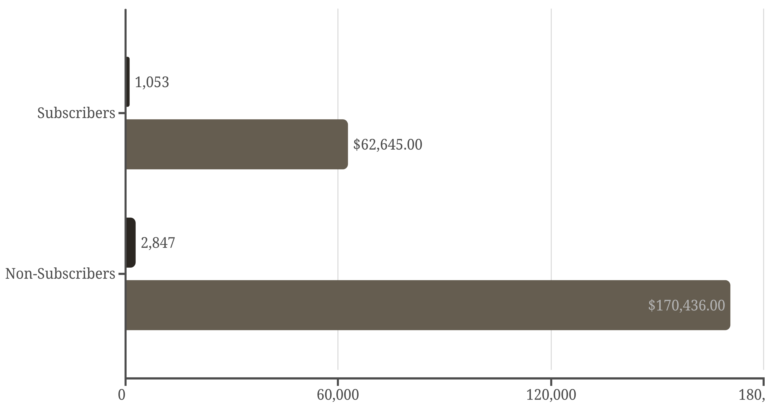
Subscription Analysis
Customers
Revenue
Repeat Buyers
Opportunity
958 subscribers with 5+ purchases vs. 2,518 non-subscribers
Only 27% subscription rate - massive growth potential

Slide 9

Customer Segmentation
Returning Customers
Loyal Customers
New Customers
Loyal (80%)
Returning (18%)
New (2%)
Core revenue drivers - focus on retention
Growth segment - convert to loyal
Acquisition opportunity

Slide 10

Strategic Recommendations
Boost Subscriptions
Loyalty Programs
Review Discounts
Promote exclusive benefits to convert 73% non-subscribers
Reward repeat buyers to strengthen 80% loyal segment
Balance 50% discount rates with margin control
Product Positioning
Targeted Marketing
Highlight top-rated items in marketing campaigns
Focus on high-revenue segments and express shipping users

